Slide 1

Girls Who Code Teacher Training
Python
‹#›
Notes:
Session plan found here: https://docs.google.com/document/d/1-rtG9QWBIygUcapxW4HBTEETCKfW_h-LbZxDWavTrkw/edit

Slide 2

Interaction Meter
Interaction mode: You’ll be observing, participating, and leading at different times during this session. If you are ever confused what your role or task is, ask a neighbor or raise your hand.
I DO | WE DO | YOU DO

Slide 3
OBJECTIVES
By the end of this session, GTWBAT:
Write a program in Python that:
Iterates through a list
Uses conditionals
Reads in and saves an image
Scaffold a project with students
Notes:
Call on a teacher to read this
GTWBAT = Great teachers will be able to
Say:
What this is, what this isn’t:
It is going to give you some time to refresh introductory vocabulary.
It isn’t going to teach you everything about object oriented programming.
It is going to connect you to resources where you can refresh your syntactical skills
It isn’t going to teach you all of the dots, commas and colons you need to create your own class.

Slide 4
Teaching Move
Questioning Techniques
Using questions to check for understanding. Generally these are pre-planned and range in level of prompting necessary.
Questioning
Techniques
Remember: when we use it, you’ll see this icon on the slide!

Slide 5
CONTENT IN CONTEXT
Unit 1: Fundamentals
Unit 2: Applications
Unit 3: Advanced Topics
Unit 4:
Final Projects
When?: Week 2
Why?: Python is a commonly used language with fairly easy syntax.
Related Project?: Obamicon, Text Adventure
Notes:
< 1 min
Pause to give them time to read.
Say: The content we are going to learn and experiment with during this session falls near the end of SIP, after girls have learned all of the rest of their content.

Slide 6
CONTENT IN CONTEXT
Unit 1: Fundamentals
Unit 2: Applications
Unit 3: Advanced Topics
Unit 4:
Final Projects
When?: Week 4
Why?: Students will learn Django, a web framework written in Python, since they are already familiar with it
Related Project?: Portfolio page
Notes:
< 1 min
Pause to give them time to read.
Say: The content we are going to learn and experiment with during this session falls near the end of SIP, after girls have learned all of the rest of their content.

Slide 7
CONTENT IN CONTEXT
Unit 1: Fundamentals
Unit 2: Applications
Unit 3: Advanced Topics
Unit 4:
Final Projects
When?: Week 5 & 6
Why?: We return to Python to teach object oriented programming so they can learn the new concept.
No pygame this year!
Related Project?: The Social Network
Notes:
< 1 min
Pause to give them time to read.
Say: The content we are going to learn and experiment with during this session falls near the end of SIP, after girls have learned all of the rest of their content.

Slide 8


CURRICULUM FUNNEL
Learner Profile
and
Essential Questions
Big Picture
Unit Plans
Lesson Plans
Your
Decisions
Small Moments
Notes:
< 1 min
Say: We are going to be operating at the lesson/decision level for the next 90 minutes, but we’ll pull out and look bigger picture at the end.

Slide 9
AGENDA
Objectives, Context and Agenda - 5 Min
Obamicon - 45 min
Closing - 5 min

Slide 10
What does this program do?
def is_fruit(item):
if item == “apples” or item == “bananas”:
return True
else:
return False
groceries = [“apples”, “bananas”, “candy”]
for item in groceries:
if is_fruit(item):
print (“I need ” + item)
Notes:
Talk about variables (types don’t need to be declared) and whitespace

Slide 11

Obamicon
Student prompt link
Load in a picture to your program using PIL
Extract pixel data from the image
Create a new image that re-colorizes each pixel
Use at least one function
Save the resulting image
Notes:
Call on a teacher to read this
GTWBAT = Great teachers will be able to
Say:
What this is, what this isn’t:
It is going to give you some time to refresh introductory vocabulary.
It isn’t going to teach you everything about object oriented programming.
It is going to connect you to resources where you can refresh your syntactical skills
It isn’t going to teach you all of the dots, commas and colons you need to create your own class.

Slide 12
Obamicon - Understand Prompt
Questioning
Techniques
What library are we using for Obamicon? Why? How do you add it?
What does your program need to input?
What does your program need to output?
Notes:
Call on a teacher to read this
GTWBAT = Great teachers will be able to
Say:
What this is, what this isn’t:
It is going to give you some time to refresh introductory vocabulary.
It isn’t going to teach you everything about object oriented programming.
It is going to connect you to resources where you can refresh your syntactical skills
It isn’t going to teach you all of the dots, commas and colons you need to create your own class.

Slide 13
Obamicon - Scaffolding
Questioning
Techniques
What things are in this program?
What decisions does the program need to make?
What things will it keep doing?
Notes:
Call on a teacher to read this
GTWBAT = Great teachers will be able to
Say:
What this is, what this isn’t:
It is going to give you some time to refresh introductory vocabulary.
It isn’t going to teach you everything about object oriented programming.
It is going to connect you to resources where you can refresh your syntactical skills
It isn’t going to teach you all of the dots, commas and colons you need to create your own class.

Slide 14
Obamicon - Pseudocode
For each pixel in the image:
If the pixel intensity is > 300:
Pixel color = blue
Else if pixel intensity is > 150
Pixel color = red
Else
Pixel color = white
Notes:
Call on a teacher to read this
GTWBAT = Great teachers will be able to
Say:
What this is, what this isn’t:
It is going to give you some time to refresh introductory vocabulary.
It isn’t going to teach you everything about object oriented programming.
It is going to connect you to resources where you can refresh your syntactical skills
It isn’t going to teach you all of the dots, commas and colons you need to create your own class.

Slide 15
Obamicon
Student prompt link
Load in a picture to your program using PIL
Extract pixel data from the image
Create a new image that re-colorizes each pixel
Use at least one function
Save the resulting image
Notes:
Call on a teacher to read this
GTWBAT = Great teachers will be able to
Say:
What this is, what this isn’t:
It is going to give you some time to refresh introductory vocabulary.
It isn’t going to teach you everything about object oriented programming.
It is going to connect you to resources where you can refresh your syntactical skills
It isn’t going to teach you all of the dots, commas and colons you need to create your own class.

Slide 16
REFLECTION: CURRICULUM FUNNEL
Learner Profile
and
Essential Questions
Unit Plans
Lesson Plans
Your
Decisions
Notes:
< 1 min
Say: We are going to be operating at the lesson/decision level for the next 90 minutes, but we’ll pull out and look bigger picture at the end.

Slide 17
REFLECTION: BIG PICTURE
Discuss with a partner:
How might learning about Python inform or change a student’s answer to one of the Essential Questions below?
What is Computer Science?
What tools do computer scientists use to solve problems?
How and why do we use computer science to solve problems?
How might this project help girls build the qualities in the Learner Profile?
Notes:
< 1 min
Say: We are going to be operating at the lesson/decision level for the next 90 minutes, but we’ll pull out and look bigger picture at the end.

Slide 18
CLOSING: HOW DID WE DO?
By the end of this session, GTWBAT:
Write a program in Python that:
Iterates through a list
Uses conditionals
Reads in and saves an image
Scaffold a project with students
Notes:
Call on a teacher to read this
GTWBAT = Great teachers will be able to
Say:
What this is, what this isn’t:
It is going to give you some time to refresh introductory vocabulary.
It isn’t going to teach you everything about object oriented programming.
It is going to connect you to resources where you can refresh your syntactical skills
It isn’t going to teach you all of the dots, commas and colons you need to create your own class.

Slide 19
Training Progress
Friday | Saturday | Sunday
Classroom Mgmt | OOP | Final Projects
How to Use Curriculum | Robotics | SIP Simulation
Escalation Process | Diversity and Inclusion
Python |  | Training to Week 0
Django

Slide 20
CLOSING: THANK YOU!
Notes:
Call on a teacher to read this
GTWBAT = Great teachers will be able to
Say:
What this is, what this isn’t:
It is going to give you some time to refresh introductory vocabulary.
It isn’t going to teach you everything about object oriented programming.
It is going to connect you to resources where you can refresh your syntactical skills
It isn’t going to teach you all of the dots, commas and colons you need to create your own class.

Slide 21
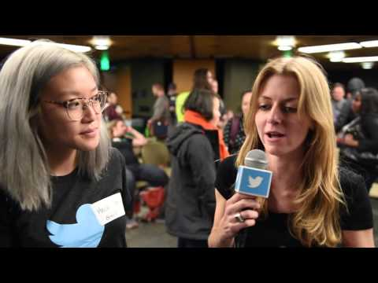
HOOK
Jessica McKeller
Director of Python Software Foundation
Why does she love Python?
Why does she love programming in general?
Notes:
3 min to find a partner to talk.
1 min to share out/return to seats
1 min - Analogies and connections to real life are great ways to explain these coding concepts to students. We are going to leverage this during this session.

Slide 22
Questioning
Techniques
Running Python Programs
Eyes closed: thumbs up/down/in between, how comfortable are you with Python syntax?
How does Python make decisions?
How does Python store data? Do types matter?
How does Python repeat things?

Slide 23
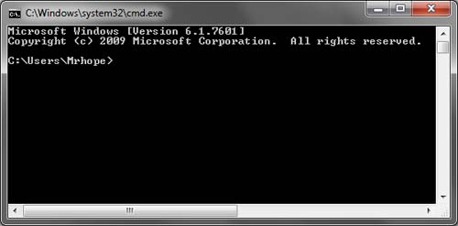
Using the Terminal / Command Prompt
Windows
Open Command Prompt
Mac / Linux
Open Terminal

Slide 24
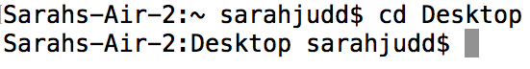
Using the Terminal / Command Prompt
Mac / Linux
Ls - list what is here
Mkdir - make directory
Cd - call directory
Windows
Dir - list what is here
Mkdir - make directory
Cd - call directory

Slide 25
Running Python Programs
Create a file in a text editor of your choosing
Write the following in your text editor:
print(“Hello World”)
Save the file to your Desktop as GWCtest.py
Open your Command Line or Terminal
Call your Desktop from the command line or terminal
cd Desktop
Run the python program
python3 GWCtest.py
Hello World should print to your screen

Slide 26
Questioning
Techniques
Running Python Programs
Eyes closed: thumbs up/down/in between, how comfortable are you with the command prompt
What is a “directory”?
How can you tell what directory you’re in?
How can you change directories?

